Slide 1
Final Project Debrief
Jared Sherwood

Slide 2
PROCESS
Generate Training Data
1
Train Model
2
Implement Detection
3
Create Stories
4
Implement Cozmo
Notes:
There is also the step of creating detection zones inside the video, and using cozmo

Slide 3
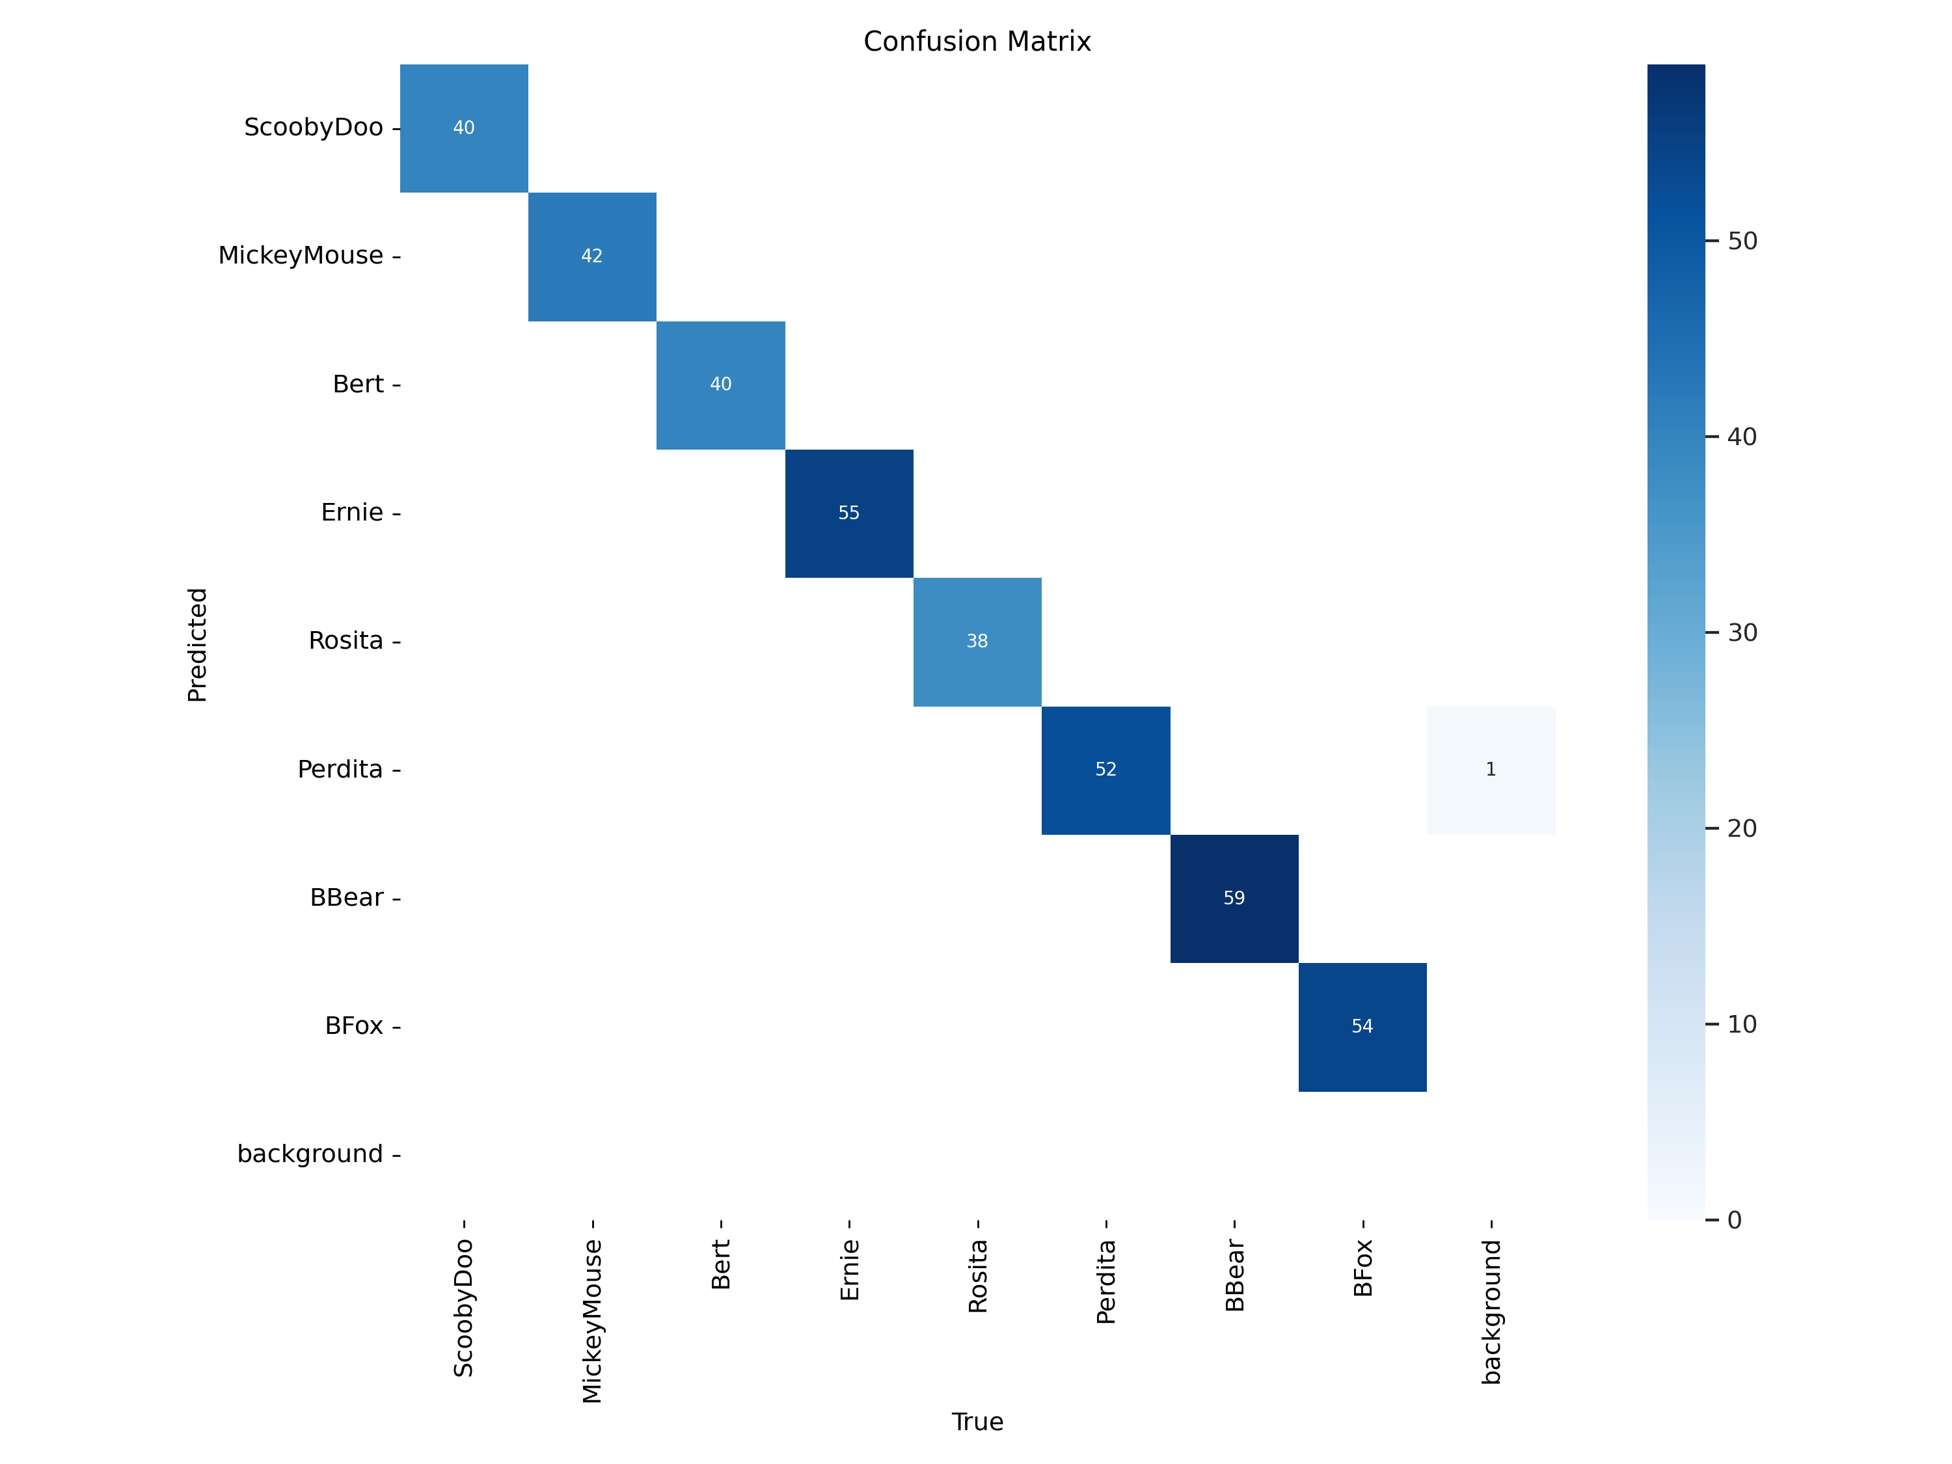

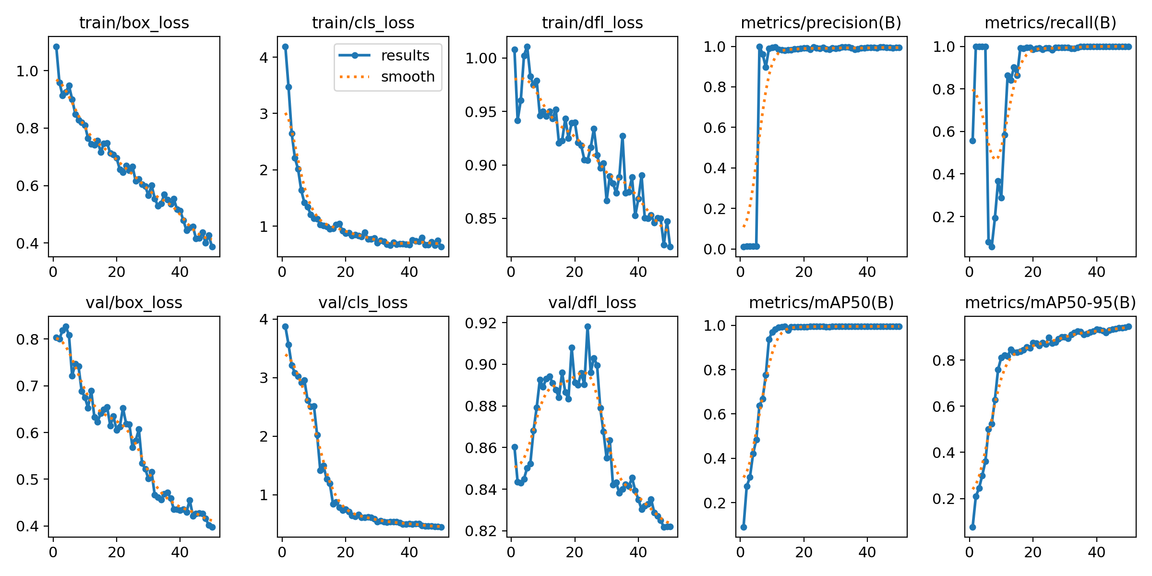
THE GOOD
Accuracy
Tracking
ChatGPT Integration
Cozmo’s Voice

Slide 4
THE BAD
Processing Speed
Cozmo’s Camera
Cozmo’s Reading Speed
Lost Features
Limited Testing

Slide 5

DEMO

